Slide 1
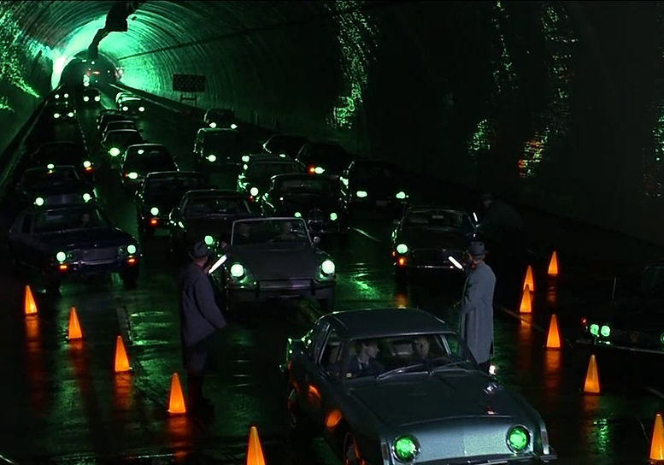
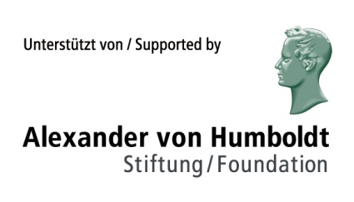
Changing the (Semantic) Frame Intermodal Contrast as a Narrative Device in Film
Martin Siefkes Chemnitz University of Technology

Slide 2
Overview
Intermodal interaction types (IITs)
The IIT Intermodal contrast
Multimodality and semantic frames
Three filmic examples

Slide 3
What are intermodal interactions?
In multimodal texts, semiotic modes are closely integrated – how to describe this?
Academic disciplines traditionally look at separate modes (e.g. language, music, images, gesture)
Multimodality research often focuses on the “holistic picture”
Intermodality / cross-modality: additional textual properties that are caused by relations between modes
Intermodal interaction types (IITs): one mode influences the other in a definable way
Martin Siefkes (in print), „How semiotic modes work together in multimodal texts: Representing intermodal interactions “. 10plus1 – Living Linguistics 1/2015.

Slide 4
Layers in multimodal texts
Text with modes
M₁, …, M_{n}
[Layer]
Mode-specific structure
for M₁, …, M_{n}
All interactions
I (M_{i}, …, M_{j})
for i, j ∊ n; i ≠j
Holistic meaning

Slide 5
Example 1
Gattaca (1997, dir. Andrew Niccols)
13:06 – 14:28
Gattaca describes a future “not too distant” from 1997 in which eugenics, and discrimination based on gene tests, are widespread
Refers to highly charged discourses of the time

Slide 6
Intermodal contrast
Anton and Vincent are playing the game of “chicken”, by swimming out to sea
[Mode₁] Narrator’s commentary:
“By the time we were playing at blood brothers, I understood there was something very different flowing through my veins, and I’d need an awful lot more than a drop if I was going to get anywhere”
[Mode₂] Moving images: Anton doesn’t scratch himself with the sharp shell offered by Vincent
Two interpretations are possible:
a) Anton doesn’t want to be Vincent’s blood brother
b) Anton is the “chicken” (= coward), he doesn’t dare to scratch himself

Slide 7
Intermodal contrast
Could be interpreted as the IIT Intermodal disambiguation
Narrator’s commentary explains Anton’s behavior
However: later in the film, Anton is the “chicken”, he loses the game twice in decisive situations!
Intermodal contrast has a double function:
1. explains us Vincent’s understanding at the time (intradiegetic information)
2. Narrative hint (extradiegetic information) that Vincent is more courageous
Facial expression (as a further mode) supports this (“fearful expression”)
haemophobia (fear of blood)

Slide 8
Example 2
Strange Days (1995, dir. Kathryn Bigelow)
6:35 – 7:26
Another dystopian science fiction film
Story about the risks of virtual-reality-recordings of violence and sex used as drugs (“Wire tripping”)

Slide 9
Intermodal contrast
[Mode₁] Moving images:
Lenny Nero is travelling in his car through Los Angeles, during Christmas holidays before New Year’s eve of the year 2000. Among other scenes of street violence, we see how a man dressed as Santa Claus is chased and assailed.
[Mode₂] Music: “Amen” aus Stabat Mater by Giovanni Pergolesi (piece 12: Quando Corpus – Amen)

Slide 10
Intermodal contrast
Straightforward relation of contrast:
Music one the radio is Christian and fits the Christmas mood
Street violence in the moving images is in stark contrast
Thematic relationship produces intermodal contrast:
Christian music ⇔ images of the hunted “Santa”
Could also be interpreted as Intermodal irony
The music expresses the traditional image of Christmas
Images are an ironic commentary on the “Christmas message”
“Amen” translates as ‘so be it’: Music as ironic commentary on images

Slide 11
Intermodality and semantic frames

Slide 12
What are semantic frames?
Background knowledge in texts
Two traditions: Artificial intelligence research and Frame semantics (Minsky 1975, Schank/Abelson 1977).
Linguistics: development of case grammar (Charles J. Fillmore; Ziem 2012)
Verb arguments have semantic roles (e.g. Agent, Object, Goal, Location, etc.)
Computer linguistics: Knowledge representation: ontologies; FrameNet; Semantic Web (OWL)

Slide 13
Semantic frames in film
All semiotic artefacts are structured by frames
Frames can be used to describe background knowledge in a general format
Intermodal relations can be established through frames

Slide 14
Social / cultural change and textual depictions
Frames describe the conceptualisation of a domain of a society
Changing understanding of cultural domains can be understood as frame change
Frame theory can be applied in film analysis: e.g. by comparing films from different times or cultures
In Gattaca, changing conceptualisations are part of the subject matter of the film

Slide 15
Example 3
Gattaca (1997, dir. Andrew Niccols)
9:00 – 10:35

Slide 16
Intermodal differences between semantic frames
Music & images of the conception scene refer to the frame Conception & Birth (1997)_{real}
Verbal language [narrative commentary] refers to the frame Conception & Birth (not-too-distant future)_{real}
Intermodal irony or Intermodal commentary
⇒ additional textual properties!
Gattaca, 10:35 – 10:58: images give examples for what is more generally described in the verbal commentary. ⇒ Exemplification

Slide 17
Frame Conception & Birth (1997)_{real}
Actors: mother, father, child, doctor, …
Events: love-making, conception, pregnancy, birth, health checks for the baby, …
Script: <love-making ⇒ conception ⇒ pregnancy ⇒ birth ⇒ health checks>
Locations: private home, hospital, …
Artefacts: hospital bed, …
Terms & idioms: “intelligence quotient”, “A child conceived in love has a greater chance of happiness”, …

Slide 18
Frame Conception & Birth (future that is “not too distant” from 1997)_{fictional}
Actors: mother, father, child, geneticist, doctor, …
Events: in-vitro fertilisation, testing of embryos, selection of suitable embryo (in consultation with the parents), conception, pregnancy, birth, genetic test, …
Locations: private home, geneticist’s practice, hospital, …
Artefacts: hospital bed, automated blood tests, genetic test set, …
Terms & idioms: “God’s child”, “faith birth”, “genetic quotient”, “borrowed ladder”, ”genoism”, …
Social norms: Discrimination is forbidden by law, but common (“No one takes the law seriously”)

Slide 19
Frame networks
Frames are connected: e.g. the frame Conception & Birth would be linked through the frame element Caesarean section with the frame Operation (hyperonym)
Links are possible via elements (e.g. actors, events …)
Connected frames (1997): connected frames are Love, Emotion, Family, Religion, Life, …
Connected frames (a future not too distant from 1997):
Genetic Engineering (contains methods of Birth & Conception)
Science (contains the social domain structuring the frame)
Eugenics (describing cultural practices and goals of the frame)

Slide 20
Framing in film
Films (and other texts) make use of frames to draw on existing cultural understanding
Thorough world construction includes fictional conceptualisation, terminology, social norms & practices
Frame templates have to be expanded accordingly
Frame change → changes in world knowledge
Use of frames to describe fictional worlds is genre specific: frequently used in science fiction & fantasy

Slide 21
Conclusion
Proposal: differentiating types of intermodal interactions (IITs)
The examples show that IITs influence textual meaning and have narrative functions
Sometimes different IITs can be assumed (depending on analysis)
IITs are connected with mode specialisation
They are an additional layer of textual meaning that has to be considered in any theory of multimodality!

Slide 22
Selected bibliography on multimodality, intermodal interactions, and frames
Bateman, John (2011), “The decomposability of semiotic modes”, in: O’Halloran, Kay & Bradley Smith (eds.) (2011), Multimodal Studies. Exploring Issues and Domains. London: Routledge, 17-38.
Bateman, John (2014), Text and Image. A Critical Introduction to the Visual-Verbal Divide. New York: Routledge.
Bateman, John & Schmidt, Karl-Heinrich (2011), Multimodal Film Analysis. How Films Mean. London: Routledge.
Calvert, Gemma, Spence, Charles & Stein, Barry (2004), The Handbook of Multisensory Processes. Cambridge MA: MIT.
Elleström, Lars (ed.) (2011), Media Borders, Multimodality and Intermediality. London: Palgrave Macmillan.
Fillmore, Charles (1982), “Frame semantics”, in: Linguistics in the Morning Calm. Papers presented at the Seoul International Conference on Linguistics. Seoul: Hanshin, 111-137.
Fricke, Ellen (2006), “Intermedialität, Stil und Mental Spaces: Das Visuelle als Dimension musikalischen Komponierens in Georg Nussbaumers Installationsoper ‘orpheusarchipel’”. Kodikas/Code 29(1-3), 137-155.
Fricke, Ellen (2013), “Towards a unified grammar of gesture and speech: A multimodal approach”, in: Cornelia Müller et al. (eds.), Body – Language – Communication. An International Handbook on Multimodality in Human Interaction. Berlin: de Gruyter, vol. 1, 733–754.
Liu, Yu & O’Halloran, Kay (2009), “Intersemiotic texture: Analyzing cohesive devices between language and images”. Social Semiotics 19(4), 367-388.
Marsh, Emily E. & White, Marilyn D. (2003), “A taxonomy of relationships between images and text”, Journal of Documentation 59(6), 647–672.
Martinec, Radan & Salway, Andrew (2005), “A system for image-text relations in new (and old) media”, Visual Communication 4(3), 339–374.
Minsky, Marvin (1975), “A Framework for Representing Knowledge”, in: Patrick H. Winston (ed.), The Psychology of Computer Vision. New York: McGraw-Hill.
Oviatt, Sharon L. (1999), “Ten myths of multimodal interaction”. Communications of the ACM 42,11: 74-81.
Schank, Roger C. & Abelson, Robert P. (1977), Scripts, Plans, Goals, and Understanding. An Inquiry into Human Knowledge Structures. Hillsdale, NJ: Erlbaum.
Siefkes, Martin (in print), “An Experimental Approach to Multimodality. Investigating the Interactions between Musical and Architectural Styles in Aesthetic Perception”, in: Building Bridges for Multimodal Research. Theories and Practices of Multimodal Analysis. Bern/New York: Peter Lang.
Siefkes, Martin (in review), “Frames in discourse. Connecting frame semantics and discourse analysis in an SDRT-based model”.
Wengeler, Martin (2003), Topos und Diskurs. Begründung einer argumentationsanalytischen Methode und ihre Anwendung auf den Migrationsdiskurs (1960–1985). Tübingen: Niemeyer.
Wildfeuer, Janina (2012), “Intersemiosis in Film: Towards a New Organisation of Semiotic Resources in Multimodal Filmic Text”. Multimodal Communication 1, 3: 276-304.

