Slide 1
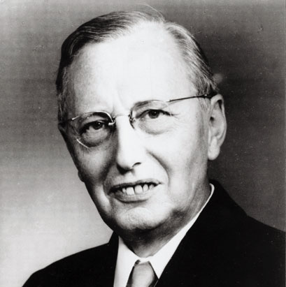
Workshop
The Foundations of Linguistics – Languages as Abstract Objects
26. – 27. June 2015, Braunschweig University of Technology
Predecessors:
Hjelmslev’s Glossematics and Linguistic Realism
Ellen Fricke & Martin Siefkes
Chemnitz University of Technology
ellen.fricke@phil.tu-chemnitz.de
www.ellenfricke.de
martin.siefkes@phil.tu-chemnitz.de
www.siefkes.de

Slide 2
Overview
Louis Hjelmslev
Hjelmslev‘s demands on a theory of language
Some important distinctions of glossematics
Hjelmslev and multimodal grammar

Slide 3
Louis Hjelmslev

Slide 4
Louis Hjelmslev (1899 – 1965)
Danish linguist
Co-founder of the Copenhagen school
Other members were: Viggo Brøndal (1887 – 1942), Hans Jørgen Uldall (1907 – 1957)
One of the most important theoreticians of structuralism

Slide 5
Louis Hjelmslev (1899 – 1965)
Together with Uldall, he developed a theory of language called “glossematics”
An outline of Glossematics (1936)
Prolegomena to a theory of language (1963; Orig: Omkring sprogteoriens grundlæggelse, 1943)
Further development of Saussure’s analysis, explicating Saussure’s notions
Glosseme = smallest units of language: e.g. phonological and semantic features
not identical with Leonard Bloomfield’s “glossemes”, which corresponds to morphemes

Slide 6
Hjelmslev’s demands on a theory of language

Slide 7
Hjelmslev‘s basic assumptions
1) What makes something a language?
2) When is a language identical with itself in various manifestations?
In Prolegomena to a Theory of Language, Hjelmslev criticised earlier schools of linguistics that concentrated on language change (such as the Young Grammarians)
Hjelmslev argues against the “humanist tradition”, which claims that no general regularities can be found
Anti-descriptivist stance

Slide 8
Demands on a linguistic theory
For every process, linguists should look for an underlying system; for fluctuations, they should search for underlying constancy (cf. Saussure: langue vs. parole)
“Voices raised beforehand […], pleading that we cannot subject to scientific analysis man‘s spiritual life and the phenomena it implies […], are merely aprioristic, and cannot restrain science from the attempt. If the attempt fails – not in particular performances, but in principle – then these objections are valid, and humanistic phenomena can be treated only subjectively and aesthetically. If, however, the attempt succeeds […] it would then remain to perform corresponding experiments in the other fields of the humanities.” (Hjelmslev, Prolegomena: 10)
Hjelmslev states clearly that linguistics should play a leading role for the humanities

Slide 9
The empirical principle
Hjelmslev formulated the empirical principle as a basis for glossematics
“The description shall be free of contradiction (self-consistent), exhaustive, and as simple as possible. The requirement of freedom from contradiction takes precedence over the requirement of exhaustive description. The requirement of exhaustive description takes precedence over the requirement of simplicity.” (Hjelmslev, Prolegomena:11)
Hjelmslev regarded glossematics as distinguished from previous theories of language by this empirical principle
It has to be set above all other principles in linguistic theory
But what is empirical about this principle? We’ll see in a moment

Slide 10
Induction in linguistic analysis
“In linguistics, we usually call this method of procedure inductive. It may be define briefly as a progression from component to class, not from class to component. It is a synthetic, not an analytic, movement […].
It inevitably leads to the abstraction of concepts which are then hypostatized as real. This realism (in the mediæval sense of the word) faisl to yield a useful basis of comparison, since the concepts thus obtained are […] not generalizable beyond a single to language in an individual stage. All our inherited terminology suffers from this unsuccessful realism.” (Hjelmslev, Prolegomena:12)
Induction is the basic principle of “previous linguistics”, Hjelmslev claims
from individual sounds to phonemes (classes of sound)
from individual meanings to general or basic meanings (of lexemes)
etc.

Slide 11
Induction in linguistic analysis
Induction: generalisation from observed facts to general rules (David Hume)
Hjelmslev points out that categories (class concepts) in traditional grammatics are won by induction from properties of observed category members
In language: e.g. grammatical categories such as genitive, perfect, subjunctive, or passive, are applied to different phenomena in various languages (e.g. Latin and Greek)
Inductive analysis can‘t ensure a self-consistent and simple description
Other methods of description and evaluation have to be found (cf. Martin Neef’s argument for a phonology independent of phonetics)

Slide 12
Hjelmslev’s deductive approach
Hjelmslev proposes a deductive approach
Only the unanalysed text can be regarded as empirical data
“If the linguistic investigator is given anything […], it is the as yet unanalyzed text in its undivided and absolute integrity. Our only possible procedure, if we wish to order a system to the process of that text, will be an analysis, in which the text is regarded as a class analyzed into components, then these components as classes analyzed into components, and so on until the analysis is exhausted.” (Hjelmslev, Prolegomena: 12-13)

Slide 13
Relation of theory and empirical data
Principle of arbitrariness: A theory should be independent of previous experience
“It constitutes what has been called a purely deductive system, in the sense that it may be used alone to compute the possibilities that follow from its premisses.” (Hjelmslev, Prolegomena, 14)
This priniciple ensures that a priori methodology (e.g. search for symmetries) is allowed (Hjelmslev’s father was a mathematician!)
Principle of appropriateness: Premisses which explain certain empirical data are postulated as generally as possible.
Arbitrariness ensures that limits of experience do not determine the theory; appropriateness guarantees its explanatory value.

Slide 14
Hjelmslev on realism in linguistics
“Thus, if linguistic theory […] is set in relation to the concept of reality, the answer to our question, whether the object determines and affects the theory or vice versa, is ‘both … and’: by virtue of its arbitrary nature the theory is arealistic; by virtue of its appropriateness it is realistic (with the word realism taken here in the modern, and not, as before, in the mediæval sense).“ (Hjelmslev, Prolegomena, 15)
In the Prolegomena, Hjelmslev distinguishes between three different types of realism:
Mediæval realism: hypostatizing concepts as real (opposed to nominalism)
Modern realism: analysis starting from the empirically given
Naïve realism: supposes that the objects in the domain of a science are directly empirically given
Notes:
Nominalism is possibly one source for modern semiotics!

Slide 15
Glossematics and linguistic realism
The generative paradigm building on Noam Chomsky’s understanding of language equates “language” with “language knowledge”
Theories of grammar in this narrow sense only consider language competence
In Chomsky’s competence vs. performance distinction, “performance” is banned from linguistic investigation
So-called traditional grammar, as well as structuralist approaches are not considered as grammar theories (Sternefeld & Richter 2012; cf. Neef 2014)
It has been shown (in work by Jerrold J. Katz, Paul Postal, and Hans-Heinrich Lieb, among others) that this paradigm is contradictory
Linguistic realism (Neef 2014) can be regarded as a new paradigm in linguistics
Notes:
Nominalism is possibly one source for modern semiotics!

Slide 16
Glossematics and linguistic realism
Linguistic realism regards language as an abstract object, an assumption shared by Hjelmslev and structuralism generally, which regards language as a sign system
Glossematics is a theory of language of which not all aspects (assumed categories and properties) are empirically accessible
Cf. the arbitrariness principle
The empirical principle together with the principle of arbitrariness ensures that consistency is placed over empirical verification of theoretical categories
Hjelmslev’s reflections lend themselves to a criticism of approaches that draw theoretical categories from the empirical data
Notes:
Nominalism is possibly one source for modern semiotics!

Slide 17
Double articulation
Double articulation is described by Hjelmslev as the relation from figurae [e.g. phonemes, graphemes] to signs [e.g. morphemes]
Languages have a limited repertoire of figurae
Figurae distinguish signs / meanings and follow combination restrictions
Notes:
Cognitive linguistics would certainly fall through in this criterion.

Slide 18
Characterising languages
“Languages, then, cannot be described as pure sign systems. By the aim usually attributed to them [communication; M.S.], they are first and foremost sign systems; but by their internal structure they are first and foremost something different, namely systems of figurae that can be used to construct signs.” (Hjelmslev, Prolegomena: 47)
Language is a sign system in regard to its external functions
However, in its internal functions, it is a system of a limited set of figurae with combinatorial constraints allowing the construction of an unlimited set of signs
This is relevant for psychological aspects (language acquisition, memory, …)
Notes:
A brilliant definition. – A bridge to cognitive aspects could be built via the “internal functions”.

Slide 19
Some important distinctions of glossematics

Slide 20
Expression and content
Two planes of a text: expression plane vs. content plane
Cf. Saussure’s dichotomy signifiant vs. signifié
The planes are only defined by their interdependence, neither can be identified on its own (→ Saussure)
Both planes are similarly structured:
material vs. substance vs. form
Notes:
Cognitive linguistics would certainly fall through in this criterion.

Slide 21
Expression and content
material vs. substance vs. form
material: amorphous, semiotically unstructured
substance: semiotically formed material
form: structure (defined by oppositions, i.e. distinctions on the respective other plane)
only the form (on both planes) constitutes the sign!
Substance sciences (e. g. phonetics) do not belong to linguistics proper
Notes:
Cognitive linguistics would certainly fall through in this criterion.

Slide 22
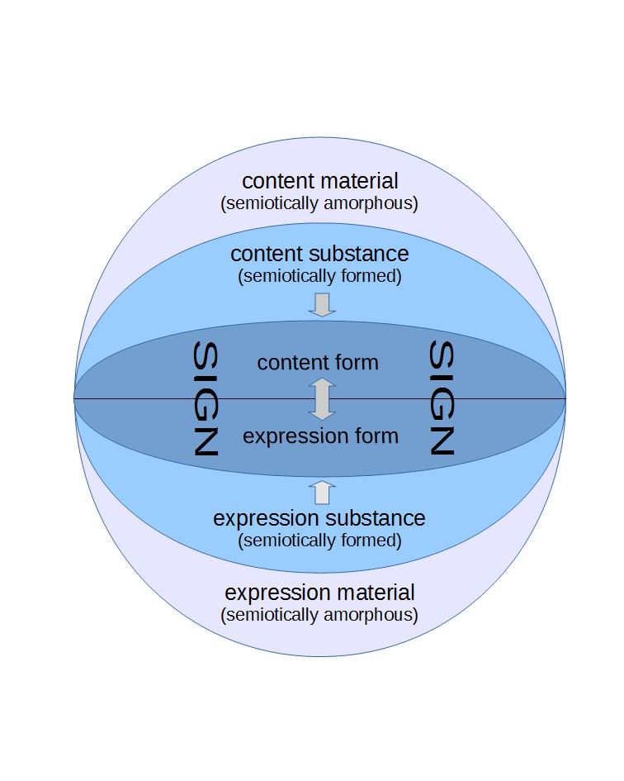
Figure 1:
Hjelmslev’s sign model (after Nöth 2000: 81).

Slide 23
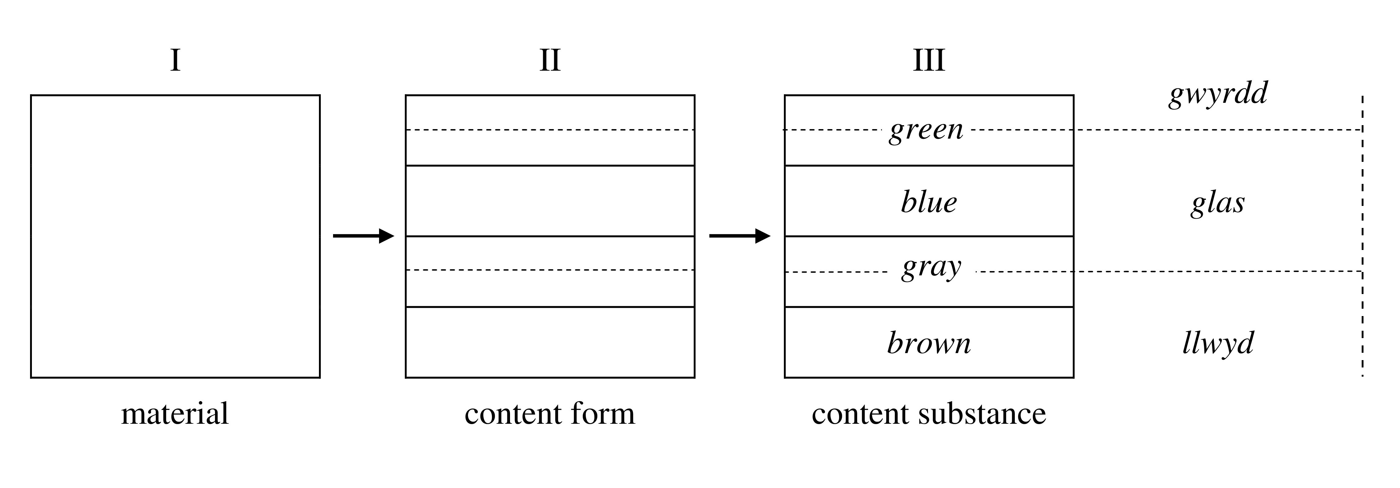
green | gwyrdd
 | glas
blue
gray
 | llwyd
brown
Figure 2:
Terms for the colour spectrum in English and in Welsh (after Hjelmslev 1963: 53).
Figure 3:
The relationship between form, material, and substance illustrated for the colour spectrum (following Trabant, cf. Krampen 1981: 152).

Slide 24
Tests for determining units
by paradigmatic exchange: replacement test
by syntagmatic exchange: commutation test
figurae: “minimal change” on the other level in the replacement test
-emes: limited number of correlates on the other level in the commutation test
Notes:
Cognitive linguistics would certainly fall through in this criterion.

Slide 25
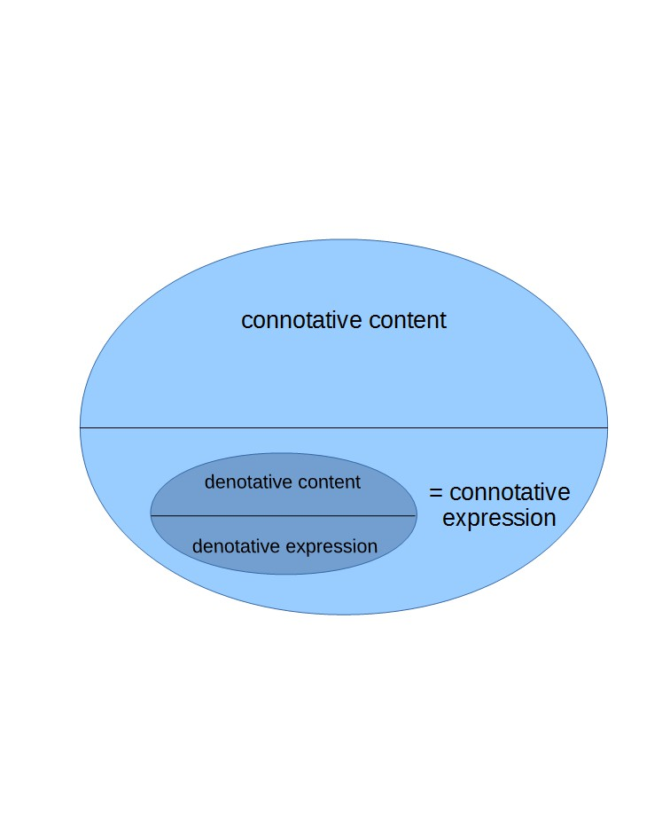
Recursive use
Figure 4:
Hjelmslev’s model of a connotative sign (cf. Nöth 2000: 86).

Slide 26
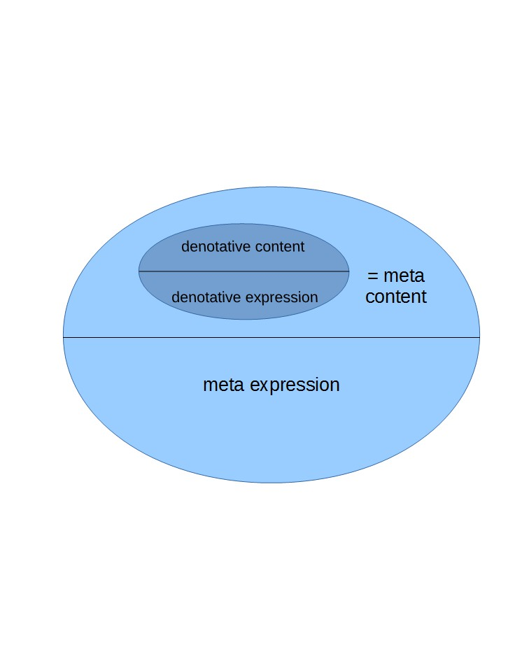
Recursive use
Figure 5:
Hjelmslev’s model of a meta sign (cf. Nöth 2000: 87).

Slide 27
Hjelmslev and multimodal grammar

Slide 28
Language in different manifestations
Glossematics doesn’t privilege speech over gesture, and criticises the dominance of phonetics
The integral text is the only ‘input’ for analysis
“The long supremacy of conventional phonetics has, moreover, had the effect of restricting the linguists’ conception even of ‘natural’ language in a way that is demonstrably unempirical, i.e., inappropriate because non-exhaustive. It has been supposed that the expression-substance of a spoken language must consist exclusively of ‘sounds.’ Thus, as has been pointed out by [Eberhard und Kurt Zwirner] in particular, the fact has been overlooked that speech is accompanied by, and that certain components of speech can be replaced by, gesture, […] very nearly all the striate musculature, cooperate in the exercise of ‘natural language’.” (Hjelmslev, Prolegomena: 103)
Notes:
Cognitive linguistics would certainly fall through in this criterion.

Slide 29
Towards multimodal grammar
Thus, Hjelmslev explicitly includes gesture, facial expression, and body posture in language
In glossematics, these are not separate “sign systems” or “modes”, but an integral whole
Each language gives a different form to a previously amorphous material, forming it to a substance
Language (= pure form) manifests itself in different substances (modes)
For each language, a multimodal grammar has to be developed that includes all modes (= substances)
Notes:
Cognitive linguistics would certainly fall through in this criterion.

Slide 30
Towards multimodal grammar
One form (= single language) can manifest itself in different substances (e.g. sound and gesture)
Hjelmslev (Prolegomena: 103) explicitly points out that (following Saussure) substance cannot be used to define a language
Hjelmslev is thus not only a predecessor of linguistic realism, but also of multimodality!
Notes:
Cognitive linguistics would certainly fall through in this criterion.

Slide 31
Bibliography
Fricke, Ellen (2012), Grammatik multimodal: Wie Wörter und Gesten zusammenwirken. Berlin/New York: de Gruyter.
Fricke, Ellen (2013), “Towards a unified grammar of gesture and speech: A multimodal approach”, in: Cornelia Müller, Alan Cienki, Ellen Fricke et al. (eds.), Body – Language – Communication. An International Handbook on Multimodality in Human Interaction. Berlin/Boston: De Gruyter Mouton, vol. 1, 733–754.
Hjelmslev, Louis (1936), An Outline of Glossematics. Kopenhagen: Levin og Munksgaard.
Hjelmslev, Louis (1963), Prolegomena to a Theory of Language. Madison: University of Wisconsin Press. Translated by Francis J. Whitfield. First published as (1943): Omkring sprogteoriens grundlæggelse. Kopenhagen: Munksgaard.
Johansen, Jørgen Dines (1998), “Hjelmslev and Glossematics”, in: Posner, Roland, Klaus Robering und Thomas A. Sebeok (Hg.) (1997–2004), Semiotik / Semiotics. Ein Handbuch zu den zeichentheoretischen Grundlagen von Natur und Kultur. 4 vols. Berlin: de Gruyter, vol. 2: 2272–2289.
Neef, Martin (2014), “Das nächste Paradigma: Realistische Linguistik”. Muttersprache 2/2014: 105-120.
Nöth, Winfried (2000), Handbuch der Semiotik. 2nd, revised ed. Stuttgart: Metzler. 78–87.
Siefkes, Martin (2015), “Sturm auf die Zeichen. Was die Semiotik von ihren Kritikern lernen kann”. Schriften zur Kultur- und Mediensemiotik Online 1/2015: 7–42.

